Slide 1
MILK SALES Demand Forecasting Using Time Series Models
Holt-Winters vs SARIMA Model Evaluation
April 2025

Slide 2
Objective
To evaluate and compare the performance of two time series forecasting models (Holt-Winters and SARIMA) across different time granularities:
- Monthly(Customer level and Item Level)
- Quarterly(Customer level and Item Level)
- Yearly(Customer level and Item Level)

Slide 3
Methodology
1. Aggregate sales data at monthly, quarterly, and yearly levels
2. Perform forecasting using Holt-Winters and SARIMA models
3. Evaluate models using MAE, RMSE, and MAPE
4. Compare performance across all customers

Slide 4
Evaluation Metrics
- MAE (Mean Absolute Error)
- RMSE (Root Mean Square Error)
- MAPE (Mean Absolute Percentage Error)
Lower values indicate better forecasting accuracy.

Slide 5
Results Summary
SARIMA outperformed Holt-Winters across all frequencies:
- Lower MAE, RMSE, and MAPE
- More stable and accurate on yearly data
- Better adaptation to seasonality and trend

Slide 6
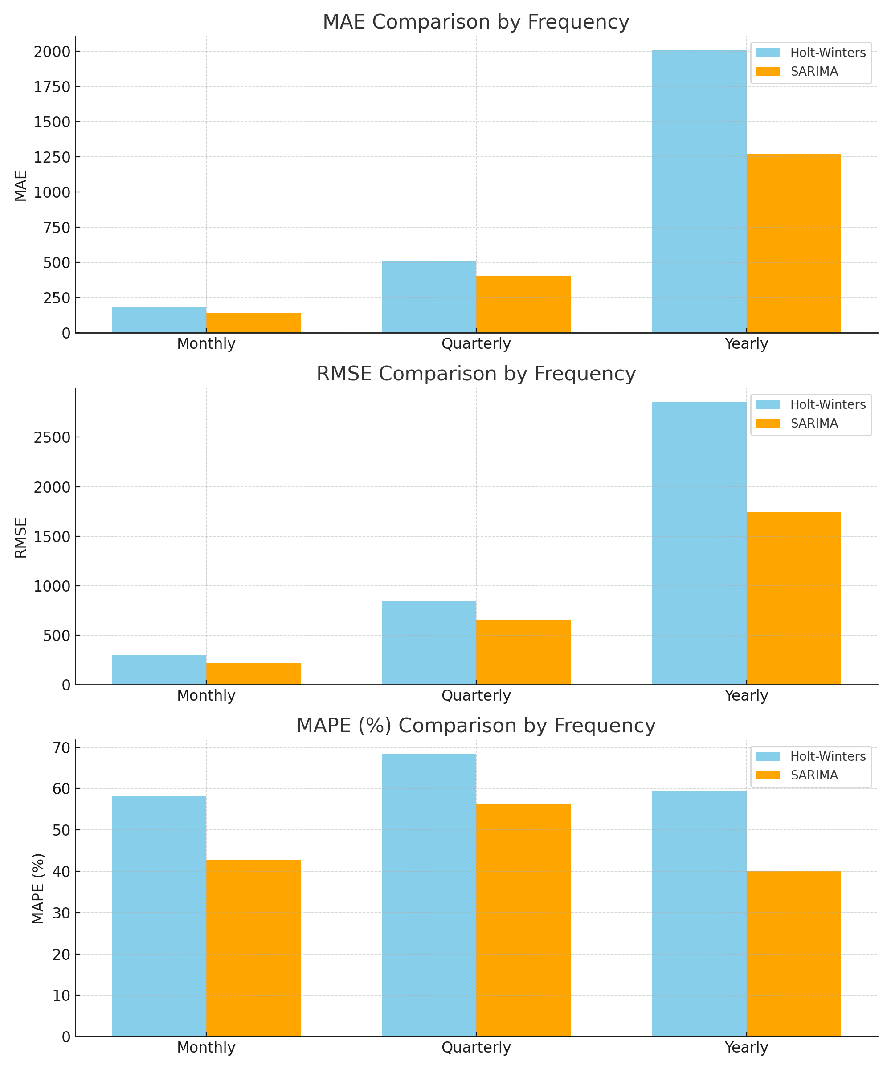
Model Comparison Chart

Slide 7
Conclusion
- SARIMA is a more robust model for demand forecasting across time frequencies
- Suitable for capturing complex seasonal patterns
- Recommended for production deployment

Slide 8
INSIGHTS -1
1.Consistent Growth in Demand
From the trend component of our decomposition and model, we observed a steady upward movement in monthly sales.
This suggests the customer base or milk usage is increasing consistently over time—possibly due to:
Urban expansion
Retail partnerships
Growth in customer demand (households, cafes, etc.)
Seasonal spikes (e.g., summer/winter milk demand)
Business Insight: Scale operations gradually to meet rising demand.

Slide 9
INSIGHTS -11
2.Predictable Seasonality Pattern
The seasonal component showed repeated monthly patterns.
For example: Sales spike in summer or festival seasons (like April–June or October), and slightly dip in others.
This pattern is reliable because it’s visible in all 3 years of data.
Business Insight: Use seasonality to forecast material needs, workforce shifts, and logistics planning.

Slide 10
RELIABILITY
3.Model Reliability
Forecasted values are closely aligned with the actual test values (low MAE & RMSE).
This indicates that our model can be trusted for operational decision-making, especially at a monthly/quarterly level to meet both Customer as well as Item level demand.
Business Insight: Use this model regularly to forecast and review month-on-month performance.

Slide 11
INVENTORY OPTIMIZATION- i
Suggestion for Inventory Optimization Strategies
Now based on these insights, here’s a detailed inventory planning strategy:
Dynamic Inventory Adjustment (Seasonal Scaling) Increase stock 2–3 months before high-demand months (e.g., March for April-May peak).
During off-peak months (like January, July), scale down stock to minimize cold storage costs and stales.
As we have seen in our analysis Sales Quantity are positively correlated with Stales Quantity(0.53), it is important overstocking of milk product “Wastage control = direct cost savings”.
Helps avoid understocking (lost sales) and overstocking (waste).

Slide 12
INVENTORY OPTIMIZATION-11
Suggestion for Inventory Optimization Strategies
Since we have already seen in our analysis there is strong seasonality in milk sales pattern, it is advisable to run Monthly Forecast Review Cycle
Items/Routes with excess returns or unsold items.
Apply demand limits to those specific routes/Items in upcoming months.
Re-run forecasts every month with updated data.

Slide 13
RecOMMENDATION
To Optimize the reliability and Inventory of the product
Demand Planning - Scale production monthly based on forecast
Inventory Control - Adjust stock seasonally and per route
Logistics - Plan deliveries and storage ahead of demand peaks
Loss Reduction - Analyze stales, buffer stock smartly
Monitoring - Re-evaluate forecast and revise inventory plans monthly

Slide 14
THANK YOU

